Slide 1

CUSTOMER LOGO
TO GO HERE
API’s for analytics
Marketing
PETER HENTY | July 2017

Slide 2
What are API’s
Application Programme Interface
Expose data to external users through standard interfaces
HTTP (Web interface
Prefer FHIR – some older ones still useful
Security included
Access control same as Portal
Privacy and logging included
Examples currently available (mostly read-only)
Admin: User, User Lists, Patient, Encounters
Clinical: Observations, Problems, Allergies

Slide 3
Current usage
Direct access to applications
Develop alternate UI to portal – eg mobile
Analytics
Single patient
Eg Framingham risk for one person
Cohort of patients
Eg Read from a list, calculate risk for each, write assessment back

Slide 4
Future Development
SMART
Write API’s

Slide 5
Demonstration
Framingham risk calculator
Risk of a CardioVascular event (eg Heart Attack) over 10 years
Developed from a study at Framingham, Massachusetts
Based on:
Age & Gender
Some blood tests (HDL LDL Cholesterol)
Blood Pressure
Smoking status
Whether diabetic

Slide 6
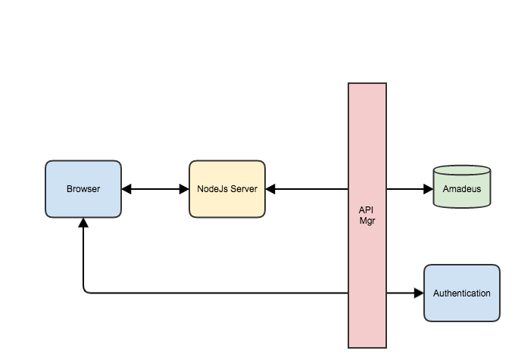
Architecture

Slide 7
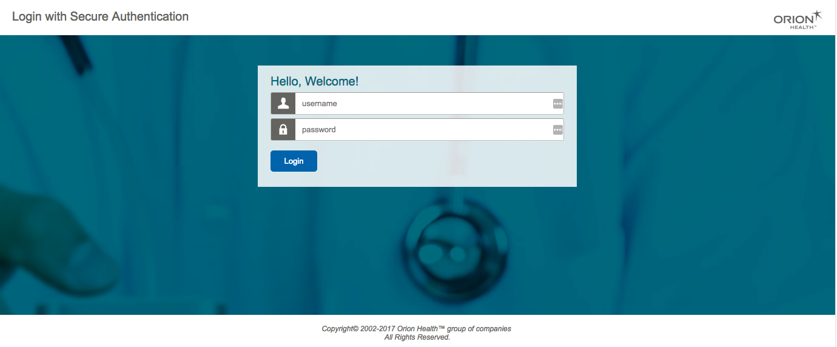
Login

Slide 8
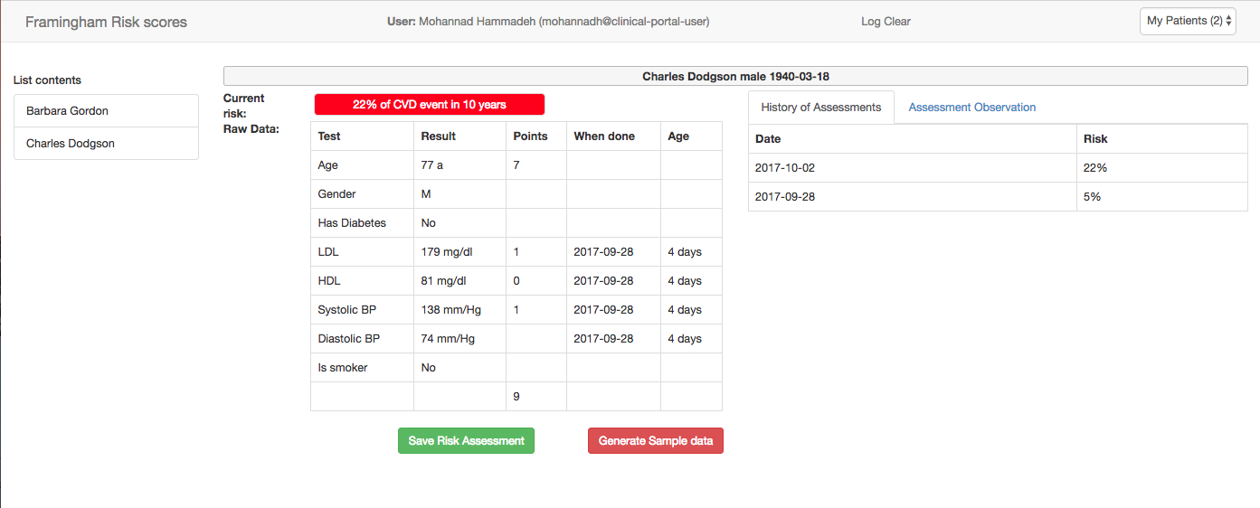
CVD Risk for a single patient

